Slide 1
Fundamental Programming in JAVA
Basics of Java Programming

Slide 2
Objectives
Describe the structure of a simple Java program.
Write a simple Java program.
Be familiar with printing outputs in Java.
Be aware of reserved keywords in Java.
Use of comments in Java programs
Become familiar with identifiers naming conventions in Java (e.g. variables , constants, classes , methods and packages).
Become familiar with primitive data types
To obtain input from the console using the Scanner class.
To read a int,, float, double ,String ,char or Boolean value from the keyboard
To cast the value of one type to another type.

Slide 3
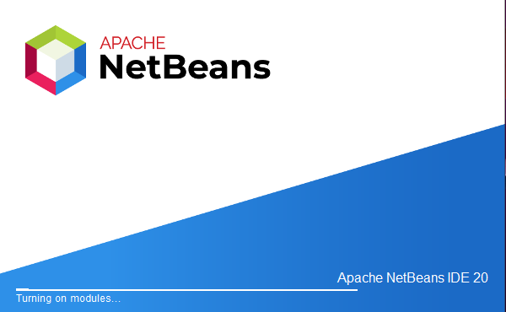
Creating first java project
To create a Java project:
Step one:
Start Apache NetBeans IDE.

Slide 4
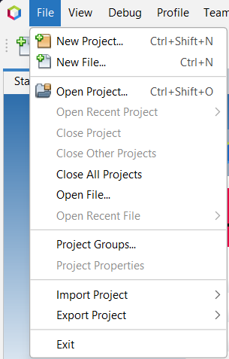
Cont. creating first java project
Step two:
In the IDE, choose File → New Project or (Ctrl-Shift-N), as shown in the Figure:

Slide 5
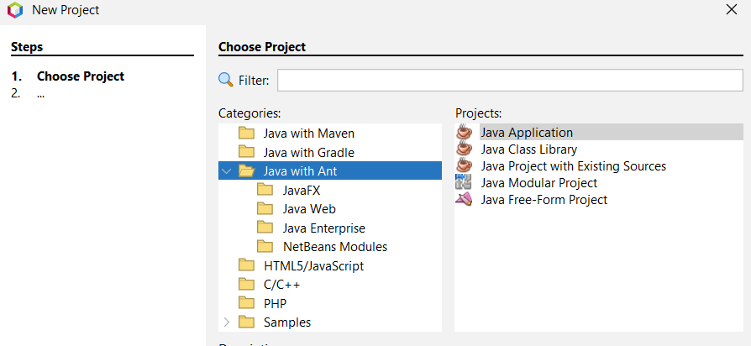
Cont. creating first java project
Step three:
In the New Project wizard, from the Categories list choose Java with Ant.
→ from the Projects list choose Java Application → Click Next >.

Slide 6
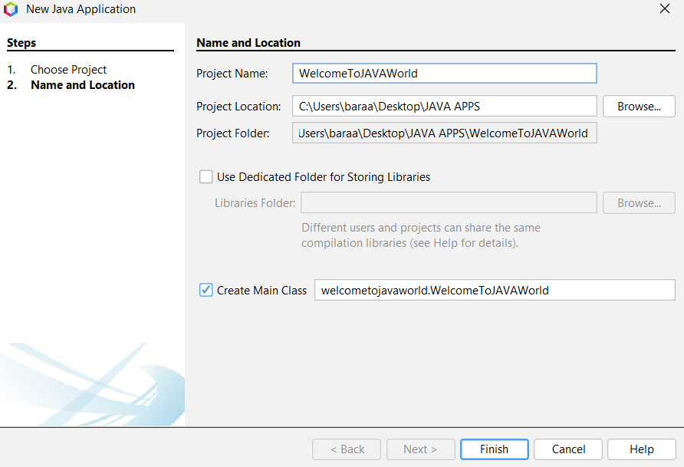
Cont. creating first java project
Step four:
In the Project Name text field, type: Welcome
Leave the Project Location text field to the default.
Leave the Use Dedicated Folder for Storing Libraries checkbox unchecked.
Leave the Create Main Class checkbox checked.
Click Finish.

Slide 7
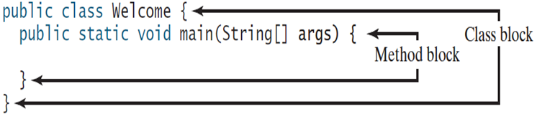
Anatomy of Java Program
A block: is a construct that groups of programming statements.
Each block begins with an opening brace { and ends with a closing brace }.
Every class has a class block that groups the data and methods of the class. Similarly, every method has a method block that groups the statements in the method. Blocks can be nested, meaning that one block can be placed within another.
The following program contains two blocks ( The class block and the main method block). The main method block is nested with the class block.

Slide 8
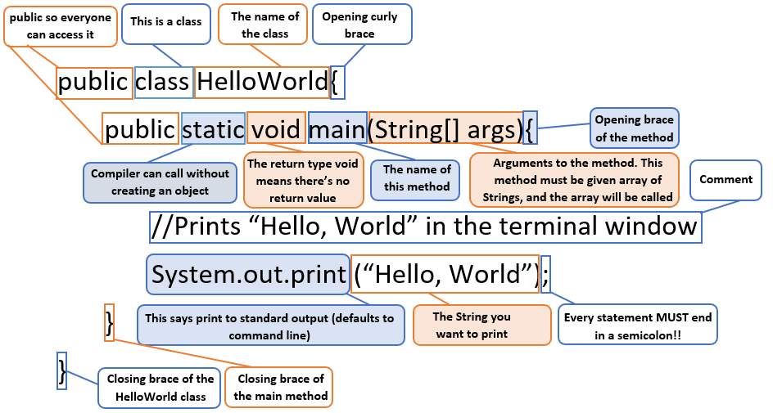
Anatomy of Java Program

Slide 9
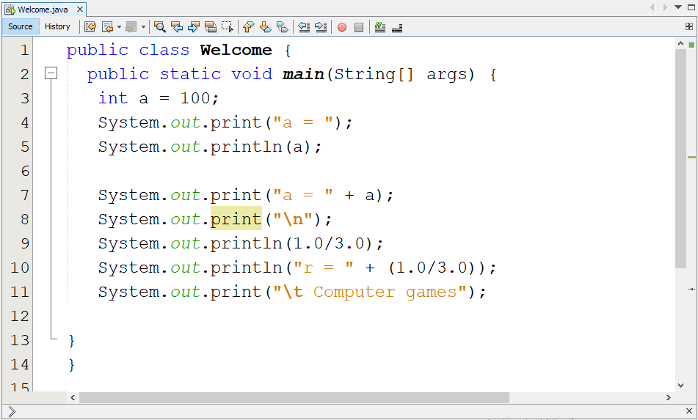
Console Output (print, println)
String concatenation

Slide 10
Exercise
Q: Write a Java code that gives the following outputs:
“Hello to the first Java program”
10 + 23 = 33

Slide 11
Identifiers
Identifiers are programmer-defined names for:
Classes
Variables
Methods
An identifier is a sequence of characters that consist of letters, digits, underscores (_), and dollar signs ($).
An identifier must start with a letter, an underscore (_), or a dollar sign ($). It cannot start with a digit.

Slide 12
Identifiers
An identifier cannot be a reserved word.
An identifier cannot be true, false, or null.
An identifier can be of any length.

Slide 13

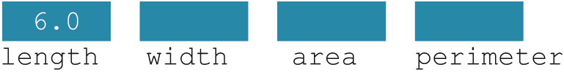
Variables
Variable: a memory location whose contents can be changed.
Memory allocation
Memory spaces after the statement length = 6.0; executes

Slide 14
Primitive Data Types
Primitive data types are built into the Java language.
There are 8 Java primitive data types.
byte
short
int
long
float
double
boolean
char

Slide 15
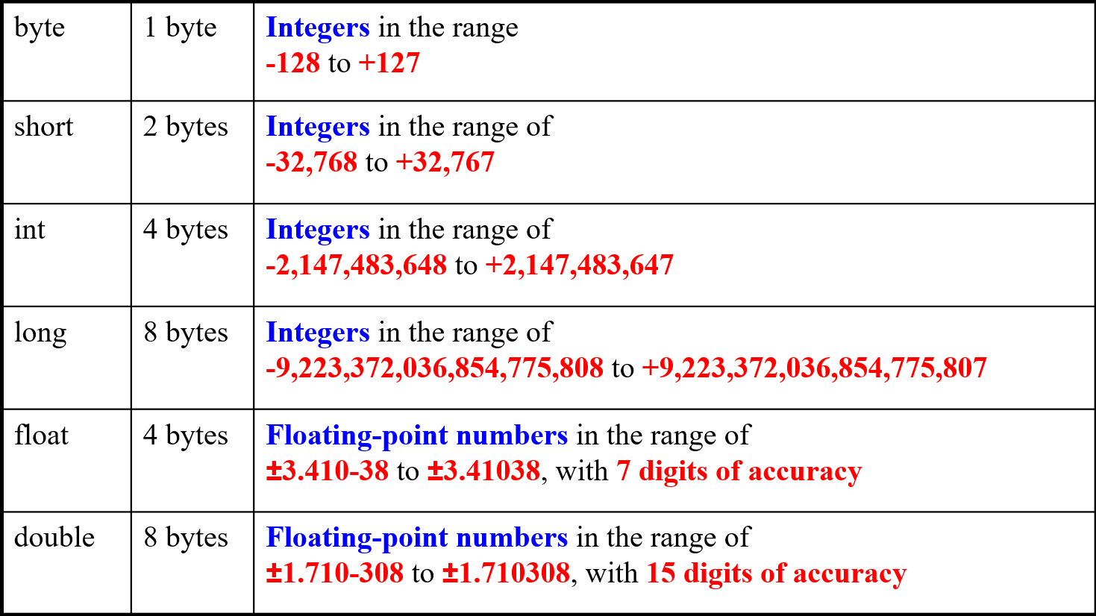
Numeric Data Types

Slide 16
double vs. float
The double type values are more accurate than the float type values. For example, double is the default. Otherwise, you have to add letter F for float as the example follows:
System.out.println("1.0 / 3.0 is " + 1.0 / 3.0);
System.out.println("1.0F / 3.0F is " + 1.0F / 3.0F);

Slide 17
The boolean Data Type
The Java boolean data type can have two possible values.
true
false
The value of a boolean variable may only be copied into a boolean variable.

Slide 18
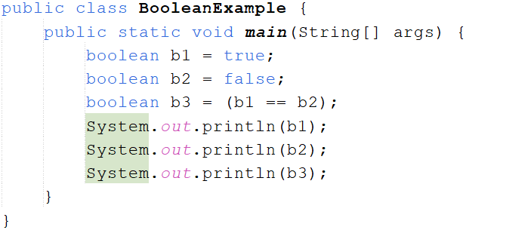
Java Program for boolean Variables
Comparison Operator

Slide 19
The char Data Type
The Java char data type provides access to single characters.
char literals are enclosed in single quote marks.
‘a’, ‘Z’, ‘\n’, ‘1’, ‘$’
Don’t confuse char literals with string literals.
char literals are enclosed in single quotes.
String literals are enclosed in double quotes.

Slide 20
Java Program for char Variables
public class CharExample {
public static void main(String[] args) {
char char1='a';
char char2='A’;
char char3=65;
System.out.println("char1: "+char1);
System.out.println("char2: "+char2);
System.out.println("char3: "+char3);
}
}

Slide 21
Naming Conventions
Choose meaningful and descriptive names.
Class names:
Capitalize the first letter of each word in the name. For example, the class name
Eg. ComputeExpression.

Slide 22
Naming Conventions
Method Name Identification
Capitalize the second and subsequent letters, without spaces between them,
Eg. (getCustomerName(), setRentalItemPrice()).
Package name
Eg. (java.util, java.lang)

Slide 23
Naming Conventions
Variables Identification:
Capitalize the second and subsequent letters, without spaces between them, e.g. (customerName, customerCreditLimit).
Constants Identification (final variables):
All letters must be capitalized, e.g.(MIN_WIDTH, MAX_NUMBER_OF_ITEMS).
Can use underscore character (_) at the beginning or in the middle or at the end of the constant name.
Cannot use spaces between letters if the constant name is compound, e.g (TAX RATE=0.16);
Uppercase and lowercase characters since the language is Case-Sensitive

Slide 24
Special Symbols

Slide 25
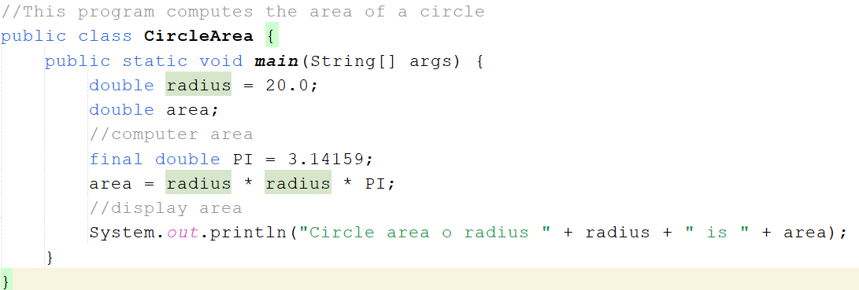
Constant Variable (final)
constant

Slide 26
Exercises
Q: write a program to compute the net salary of an employee, suppose, tax rate = 7% and employee salary = 800.
tax amount = salary * tax rate.
net salary = salary - tax amount.
Q: write a program to compute the Area of Rectangle.
width = 18.
length = 6.
Q: write a program to Swap two float numbers using a temporary variable.
Number1 = 3.4.
Number2 = 73.22.

Slide 27
Programming Errors
Syntax Errors
Detected by the compiler.
Runtime Errors
Causes the program to abort.
Logic Errors
Produces incorrect result
public class ShowSyntaxErrors {
public static main(String[] args) {
System.out.println("Welcome to Java);
}
}
public class ShowRuntimeErrors {
public static void main(String[] args) {
System.out.println(1 / 0);
}
}
public class ShowLogicErrors {
public static void main(String[] args) {
System.out.println("Celsius 35 is Fahrenheit degree ");
System.out.println((9 / 5) * 35 + 32);
}
}

Slide 28
Input Statement
In Java, Scanner is a class in java.util package used for obtaining the input of the primitive types like int, double, etc. and strings.
Using the Scanner class in Java is the easiest way to read input in a Java program, though not very efficient if you want an input method for scenarios where time is a constraint like in competitive programming.

Slide 29
How to Perform input using the Scanner class?
Before using the Scanner class, it must be imported from the java.util package. import java.util.Scanner;
In the statement that will perform the input, create an object (or instance) of the Scanner class. Scanner input;
Specify the standard input stream System.in as the stream to get the data from. input = new Scanner(System.in);

Slide 30
Performing Input Statement
import java.util.Scanner;
public class Sample1 {
public static void main(String[] args) {
Scanner input = new Scanner(System.in);
System.out.print("Enter integer number :");
int num = input.nextInt();
System.out.println(“num = “ + num);
}}
1
2
3
import java package.
Declare identifier (such as: input, read, in, …) and specify the input stream to get data from.
Use the declared scanner to input an integer value.

Slide 31
Input Statement
import java.util.Scanner;
public class Sample2 {
public static void main(String[] args) {
Scanner read = new Scanner(System.in);
double d = read.nextDouble();
System.out.println("You entered double “ + d);
byte b = read.nextByte();
System.out.println("You entered byte “ + b); } }

Slide 32
Java Scanner Input Types
Method | Description
nextBoolean() | Used for reading Boolean value
nextByte() | Used for reading Byte value
nextDouble() | Used for reading Double value
nextFloat() | Used for reading Float value
nextInt() | Used for reading Int value
nextLine() | Used for reading Line value
nextLong() | Used for reading Long value
nextShort() | Used for reading Short value

Slide 33
How to Read String in Java Next() Vs nextLine()
The next() method of the Scanner class is used for getting input from the user. In order to use the next() method of the Scanner class, an instance of the Scanner class needs to be created. The next() method stops reading input from the user until it receives a white space(" "). So, it returns the next complete token from the Scanner.
The nextLine() method of the Scanner class is also used for taking input from the user. In order to use the nextLine() method, we also need to create an instance of the Scanner class. The nextLine() method is capable of reading input till the end of the line. So, it stops reading input from the user when the user presses the enter key or line change.

Slide 34
How to Read Character in Java
java Scanner class provides nextInt() method for reading an integer value, nextDouble() method for reading a double value, nextLong() method for reading a long value, etc. But there is no nextChar() method in the Scanner class to read a character in Java. In this slide, we will learn how to take character input in Java.
To read a character in Java, we use next() of the Scanner class method followed by chatAt(0) at method of the String class.

Slide 35
How to Read Character in Java
import java.util.Scanner;
public class CharacterInputExample1{
public static void main(String[] args){
Scanner sc = new Scanner(System.in);
System.out.print("Input a character: ");
// reading a character
char c = sc.next().charAt(0);
//prints the character
System.out.println("You have entered "+c);
}}

Slide 36
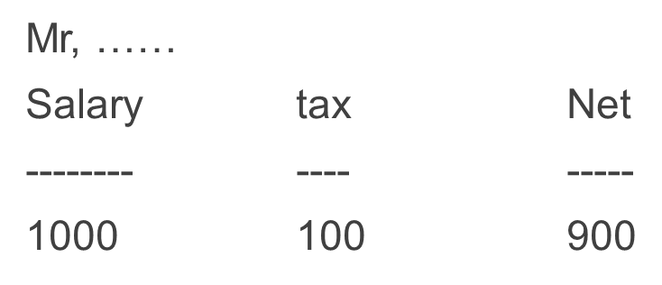
Exercises
Q: Write a java program that prompts the user to enter his name and displays the name using print statement .
Q: Write a program that prompts a user to enter the width, and the height for a rectangle, computes the area and prints the outputs.
Q :Read the employee's name, his total salary, calculate his net income after tax (10% of his salary ) and print the result in a tabular form:

Slide 37
Exercises
Q: Write a program that prompts the user to enter an integer. If the number is a multiple of 5, print HiFive. If the number is divisible by 2, print HiEven
Q: Write program which will print a message “Pass” if a student mark value is between 50-100. And print a message “Fail” if student mark less than 50.

Slide 38
Data Conversion Rules
When performing a binary operation involving two operands of different types, Java automatically converts the operand based on the following rules:
If one of the operands is double, the other is converted into double.
Otherwise, if one of the operands is float, the other is converted into float.
Otherwise, if one of the operands is long, the other is converted into long.
Otherwise, both operands are converted into int.

Slide 39
Data Conversion (Up Casting)
Consider the following statements:
byte i = 127;
System.out.println("i = " + i); // i = 127
double d = i * 3.1;
System.out.println("d = " + d); // d = 393.7
float a = i * 2.0F;
System.out.println("a = " + a); // a = 254.0
long k = 5 / 2L;
System.out.println("k = " + k); // k = 2

Slide 40
Type Casting (Down Casting)
Two types of casting:
Widening Casting (automatically - Implicit casting) - converting a smaller type to a larger type size byte -> short -> char -> int -> long -> float -> double
Narrowing Casting (manually - Explicit casting) - converting a larger type to a smaller size type double -> float -> long -> int -> char -> short -> byte

Slide 41
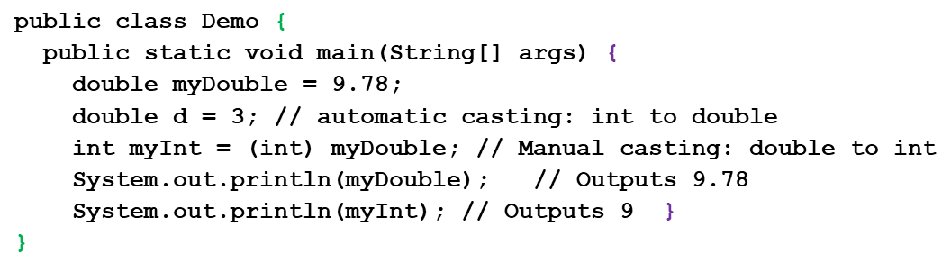
Type Casting (Down Casting)

Slide 42
Casting in an Augmented Expression
In Java, an augmented expression of the form x1 op= x2 is implemented as x1 = (T)(x1 op x2), where T is the type for x1.
Therefore, the following code is correct.
int sum = 0;
sum += 4.5; // sum becomes 4 after this statement
sum += 4.5 is equivalent to sum = (int)(sum + 4.5).

Slide 43
Parsing Numeric String
A string consisting of only integers or decimal numbers is called a numeric string
To convert a String consisting of an integer to a value of the type int, we use the following expression:
Integer.parseInt(strExpression)
Integer.parseInt("6723") = 6723
Integer.parseInt("-823") = -823

Slide 44
Parsing Numeric String
To convert a string consisting of a decimal number to a value of the type float or double type, we use the following expressions:
Float.parseFloat(strExpression)
Double.parseDouble(strExpression)
Float.parseFloat("34.56") = 34.56
Float.parseFloat("-542.97") = -542.97
Double.parseDouble("345.78") = 345.78
Double.parseDouble("-782.873") = -782.873

Slide 45
References
Introduction to Java Programming, Comprehensive Version, Student Value Edition, Daniel Liang, 12th Edition, Pearson 2019.
lecture Notes: edugate.asu.edu.jo.
lecture Videos: YouTube channel.
Lab manual 1, 2.

